Slide 1
  NSW Emerging Technology Commercialisation Fund
Jerein Kailath
Senior Manager, Strategy & Programs
April 2026
Office of the Chief Scientist & Engineer

Slide 2
Agenda
Acknowledgement of Country
About the OCSE & its commercialisation programs
ETCF program overview
Objectives & Target audience
What makes the ETCF attractive
Eligibility Criteria (applicant, grant activities, expenses)
Application Process
Assessment process & decision making
Funding Deed, reporting & repayment
Key dates
Q&A

Slide 3
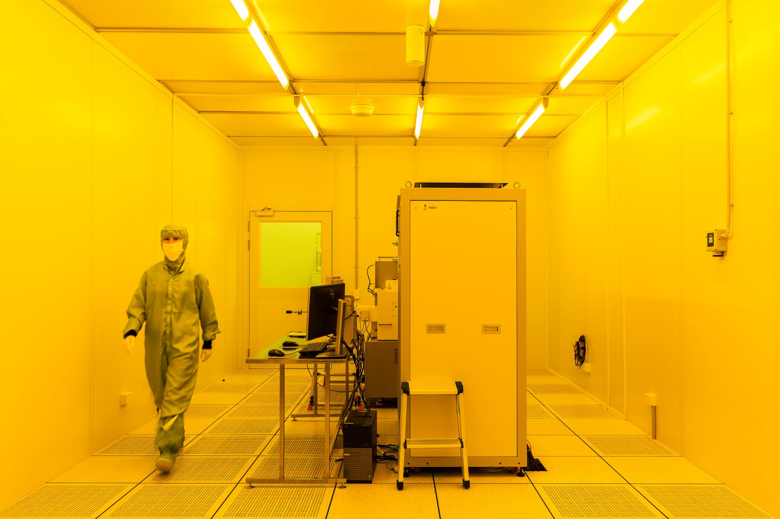
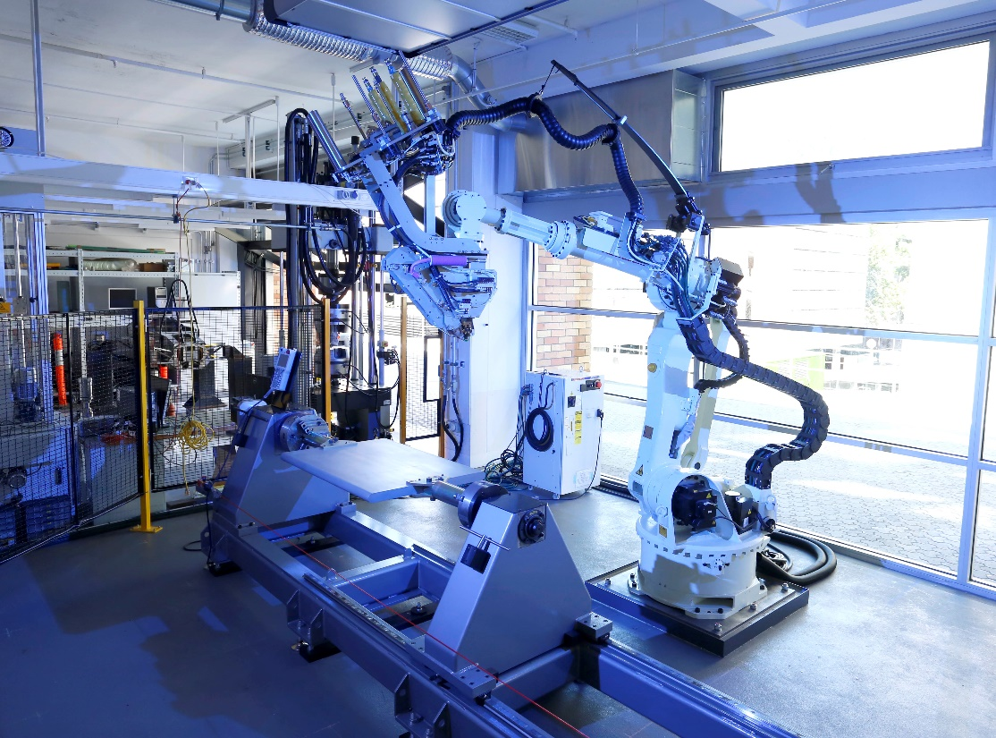
Driving innovation, industry growth and prosperity in NSW
The guiding objective of OCSE is to enable the development and application of science, engineering and technology to improve the economic, environmental and social conditions of the citizens of NSW.
The Office of the Chief Scientist & Engineer (OCSE) has four key functions:
Independent Advice
Delivering evidence-based scientific advice to government on a range of difficult challenges.
Attracting and retaining researchers and infrastructure, conference support and targeted investment.
Research Support
Industry Development
Bringing together academia, government and industry to drive the translation and commercialisation of research.
STEM Outreach and Engagement
Developing and supporting opportunities for broader and deeper engagement between science and scientists with the community.

Slide 4
OCSE Commercialisation Programs
Five rounds of the Physical Sciences Fund (2019-2022 & 2024)
Two rounds of the Biosciences Fund (2023 & 2025)
One round of the RNA Pipeline Grants (2025), Bushfire Commercialisation Fund (2023) & Quantum Computing Commercialisation Fund (2023)
Key Stats (since participation in grant program (2019 to 2024 recipients):
$435 million in additional investment
$114 million in additional grant funding
304 new jobs
Other programs: Innovation procurement grants such as the Natural Hazards Detection System, Natural Hazards Technology Program, Bushfire Technology Pilot Program, Small Business Innovation & Research Program
Notes:
32 companies

Slide 5
ETCF: Overview
Competitive grant program aimed at NSW startups
TRL scope: 3-7 (inclusive)
Funding pool: up to $7 million per round
Two Streams:
Stream A: Physical Sciences (robotics, AgTech, energy, space etc.)
Stream B: Biological Sciences (biotechnology, life sciences, food sciences etc.)
Grant size: $500,000 to $2,000,000 (excl. GST)
Applications close 10 AM 29 April 2026
Two-stage competitive process
Repayable upon commercial success

Slide 6
ETCF: Objectives & Target audience
Objectives
Progress emerging technology innovations to commercial deployment
Improve commercial viability and investment readiness
Generate long-term economic benefits to NSW
Targets
NSW-headquartered startups and small companies with innovative technologies (TRL 3-7)
Projects with strong IP position and a credible commercial pathway
Projects that create/add to NSW capabilities, jobs and supply-chain benefits

Slide 7


ETCF: What makes it attractive
    Benefits of the grant program
        Significant funding amount
        Non-dilutive funding
        No co-funding requirements
        Upfront lumpsum payment
        Performance-triggered repayment
        Supports capital-intensive commercialisation
    Benefits of application outcome
        Successful: accelerated timeline
        Unsuccessful: feedback from experts

Slide 8
Eligibility Criteria: Applicant
    Company incorporated under Corporations Act 2001 (Cth) or ATSI Corporation
    For-profit
    Not listed on any public stock exchange
    Active ABN
    Headquartered in NSW
    As of 1 Jan 2026: 65% of FTE employed in NSW
    FY 2024/25 revenue < $2.5 million
    Not a subsidiary of another company
    Own IP or hold exclusive licence to commercialise the IP globally
Office of the Chief Scientist & Engineer

Slide 9
Eligibility Criteria: Grant Activities & Expenses
    TRL 3-7 at time of application
    Stream A: existing physical prototype
    Stream B: proof-of-concept
    Project timeline: 2 years
    No prior grant funding for the same activities
    Not eligible for Medical Devices Fund
    >65% of grant funding must be spent in NSW
    Digital only applications: AI solutions, SaaS, Data platforms, Apps etc. are ineligible
    Medical Devices are ineligible
    Eligible expenses:
    Prototyping, product development, piloting studies
    Manufacturing and/or scaling
    Conducting market research, testing and trials
    Regulatory approvals and other relevant certifications
    Salaries and access to external expertise
    Commercialisation strategies and feasibility studies
    Project consumables
    Specialist equipment and/or infrastructure
    Intellectual property protection or advice

Slide 10

Application Process
Applications must be lodged through the OCSE SmartyGrants grants administration system
        Identify information to be treated as confidential
        Application must be authorised
        Late submissions not considered
One application per round (Stream A or Stream B)
Preliminary Application: 5 Questions + attachments:
        Pitch video (<5 minutes),
        Cap table,
        Org chart
Eligibility requirements need to be met at ALL times

Slide 11





Assessment Process & Decision making
25%
Solution & Value Proposition
15%
Evidence & Traction
25%
Business Model & Project Plan
20%
15%
Project Team
Impact to NSW
Stage 1: Preliminary Applications
        OCSE eligibility assessment
        Subcommittee assessment
        Expert Panel assessment
Stage 2: Full Applications
        Expert Panel assessment + interview
        Innovation, Commercialisation, Deliverability & Alignment
        Recommendation of funding recipients
        Funding decision made by Minister
Independent financial assessment and probity advice
Office of the Chief Scientist & Engineer

Slide 12
Funding Deed, reporting & repayment
Successful applicants enter into a Deed of Agreement with NSW Government
Grant paid in single tranche upon execution of Deed
Deed specifies ROI analysis (non-binding) and annual reporting requirements
Independent financial advisor undertakes annual financial monitoring
Repayments calculated when cumulative EBITDA>500,000
Repayment schedule and conditions set out in the Deed of Agreement

Slide 13
Key Dates
Stage One: Preliminary Applications open | 10:00am AEDT 6 March 2026
Stage One: Preliminary Applications close | 10:00am AEST 29 April 2026
Stage Two: Full Applications open | July 2026
Stage Two: Full Applications close | July 2026
Interviews of applicants | September 2026
Successful applicants notified | October 2026
Public announcement | November 2026
Office of the Chief Scientist & Engineer

Slide 14
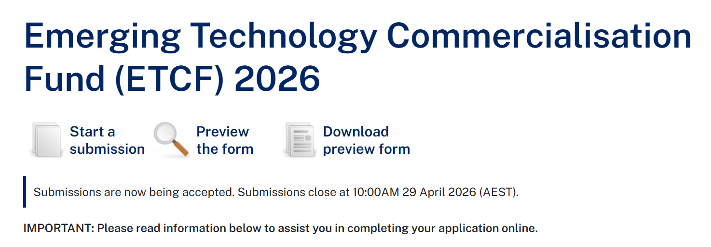
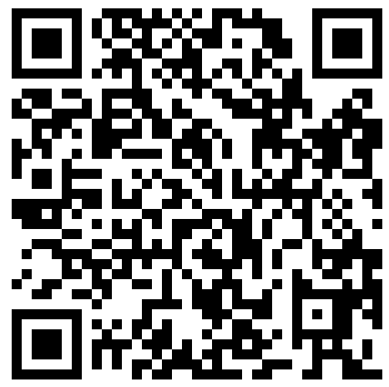
How to apply (via SmartyGrants)
https://chiefscientist.smartygrants.com.au/ETCF2026

Slide 15

Questions
For further enquiries:
grants@chiefscientist.nsw.gov.au

